Slide 1


Presentation On,
Automated Solar Positioning System using Arduino and LDR

Slide 2


Team: Error_Squad
Team Members:
MEHEDI HASAN- 2206
MUHAMMED MUMINUL HOQUE- 2207
MD. KHALED HASAN- 2235

Slide 3
Under Supervision of,
Khaleda Ferdousi
Assistant Professor of CSE
Mymensingh Engineering College

Slide 4
Introduction
Renewable energy solutions are becoming popular
Presently solar panels are of fixed type which lower the efficiency
Maximizing output from solar system increase efficiently
Automatically adjusts solar panel angles to follow the sun's path throughout the day.
Solar panels are used to convert the light energy into the electrical energy

Slide 5
What is a Solar System???
A Solar System is a device used for orienting a solar photovoltaic panel or light sensors connected to the machine (ex: stepper motor, servo motor)

Slide 6
Need for a Solar Positioning System
Increase solar panel output
Maximum efficiency of the panel
Maximize power per unit area
Able to grab the energy throughout the day

Slide 7

System Requirements
Arduino Uno
The Arduino Uno is an open-source microcontroller board based on the Microchip ATmega328P microcontroller. The board is equipped with sets of digital and analog input/output (I/O) pins that may be interfaced to various expansion boards (shields) and other circuits. The board has 14 digital I/O pins (six capable of PWM output), 6 analog I/O pins, and is programmable with the Arduino IDE (Integrated Development Environment), via a type B USB cable. It can be powered by the USB cable or by an external 9-volt battery, though it accepts voltages between 7 and 20 volts.

Slide 8
System Requirements
Servo Motor
The SG90 mini servo is lightweight, high-quality and lightning-fast. The servo is designed to work with almost all the radio control systems. It is with excellent performance brings you to another horizon of flight. The SG90 mini servo with gears and parts is perfect for R/C helicopter, plane, car, boat and truck use.

Slide 9
System Requirements
LDR Module
LDR (Light Dependent Resistor) sensor module is used to detect the intensity of light. It is associated with both analog output pin and digital output pin labelled as AO and DO respectively on the board. When there is light, the resistance of LDR will become low according to the intensity of light. The greater the intensity of light, the lower the resistance of LDR. The sensor has a potentiometer knob that can be adjusted to change the sensitivity of LDR towards light.

Slide 10



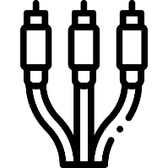




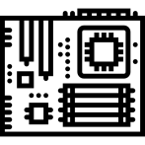
Roadmap Page
The strategy we followed for creating the project.
Collecting Equipment
Connection
Finalizing
We'll collect all the necessary equipment for the project.
Connecting the modules and motor to Arduino and power.
Checking for faulty connections or programming errors.
Creating Base
Programming
Creating base and supporting stand and surface for the project.
Creating a program for LDR modules and booting to Arduino.

Slide 11
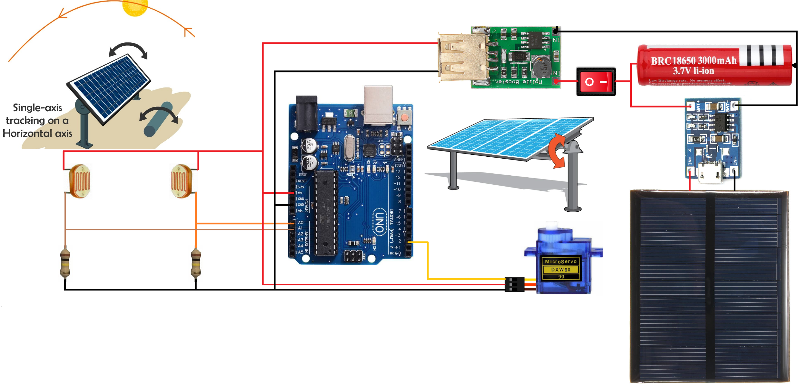
System Design
Circuit Design

Slide 12
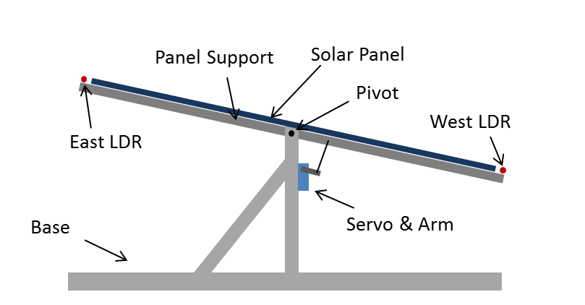
System Design
Model Design

Slide 13
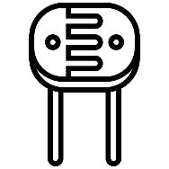
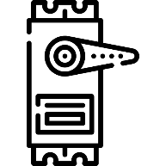
General Working Process
Adding LDR Module
Servo Motor
Programming
At first, we will add 2 LDR to our solar panel's east and west surfaces.
We will add a servo motor on the solar panels base.
We will write a program and boot it in Arduino.

Slide 14
Working Procedure
The solar panel should face the sun to harness maximum power. So, our system has two steps, first is to detect the position of sun and second is to move along with it.
Detecting the position of the Sun: We measure the intensity of light with LDRs using Arduino and compare the intensity of light falling on both LDRs. The LDRs are placed on the edges of the solar panel as shown in the figure below. Based on the intensity of light on the LDR, we give the signal to the servo motor to cause the movement. When the intensity of the light falling on the right LDR is more, the panel turns towards the right and if the intensity is higher on the left then the panel slowly turns towards the left side.

Slide 15

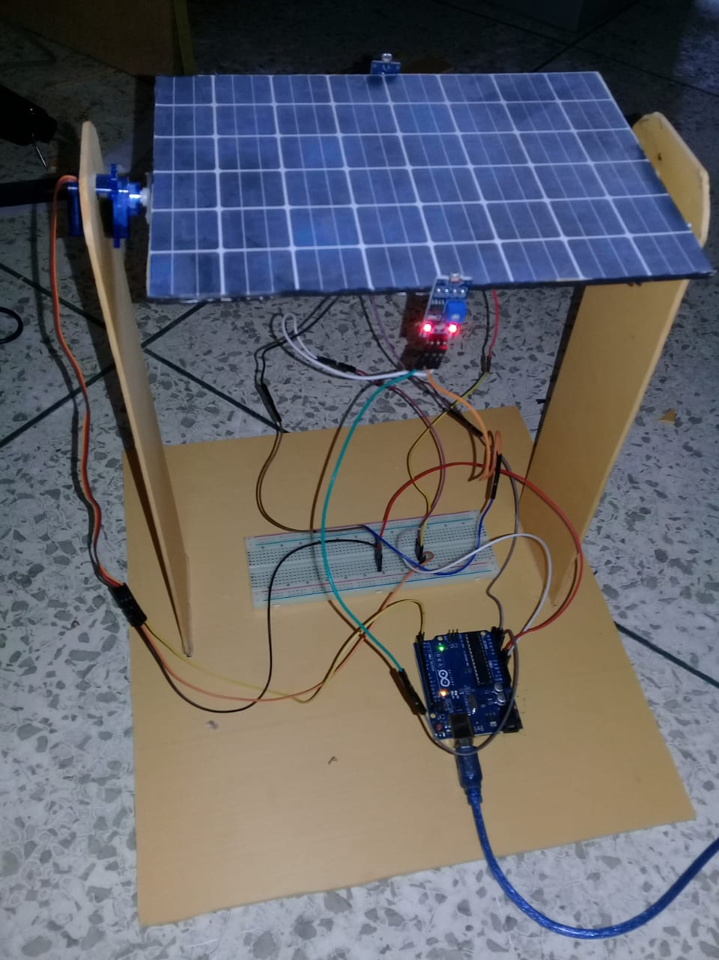
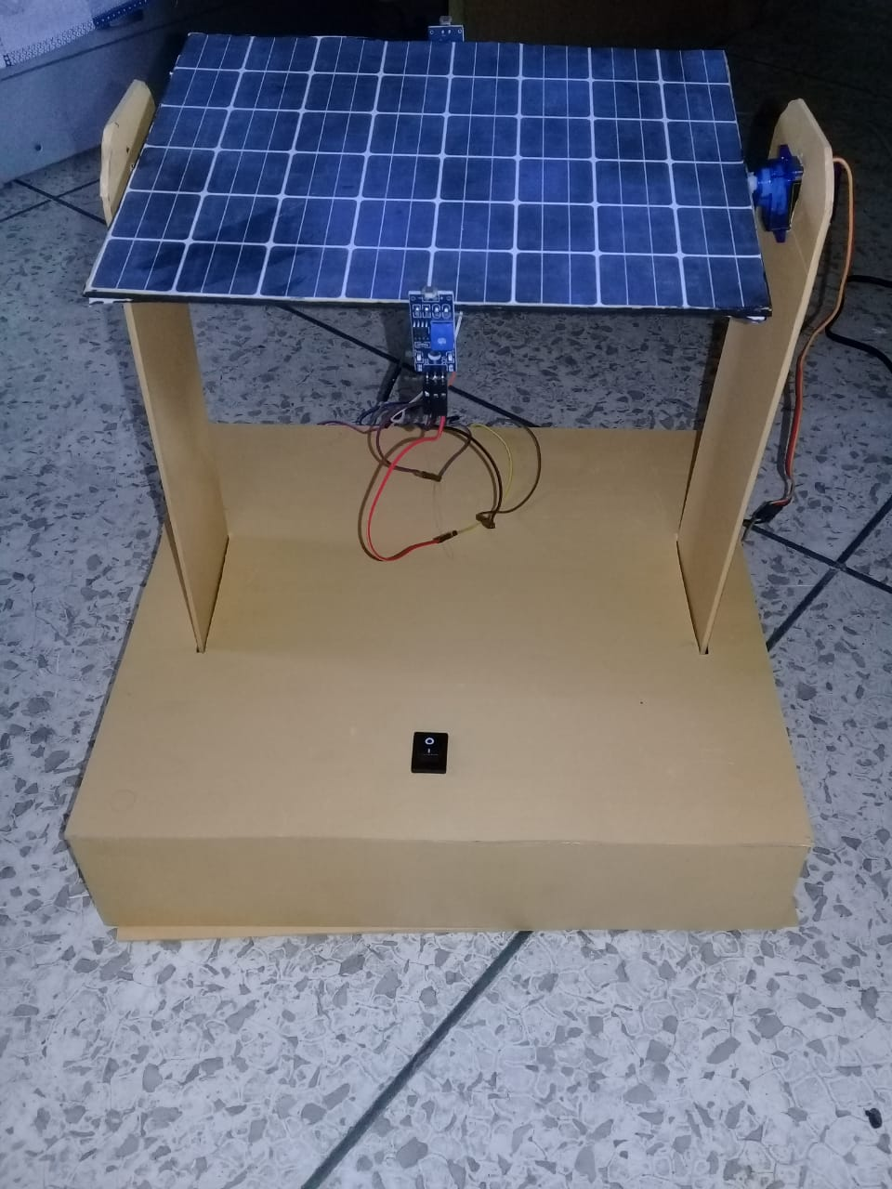
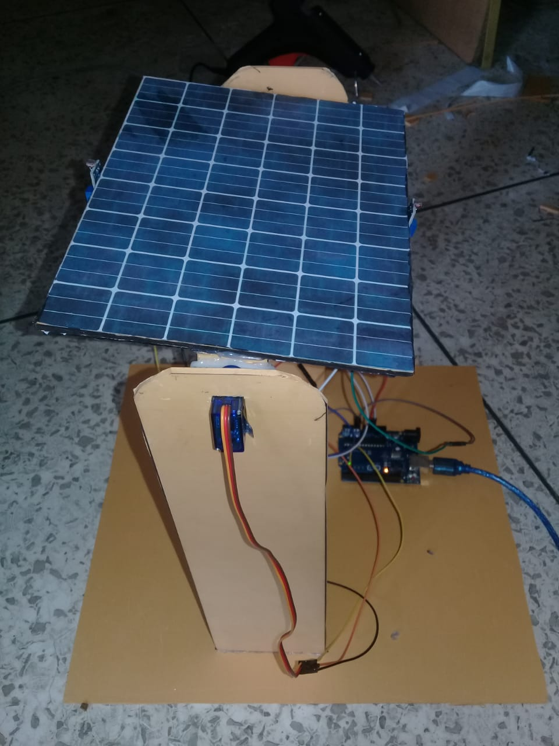
Result With Image
1
Front
2
Rear
3
Side

Slide 16
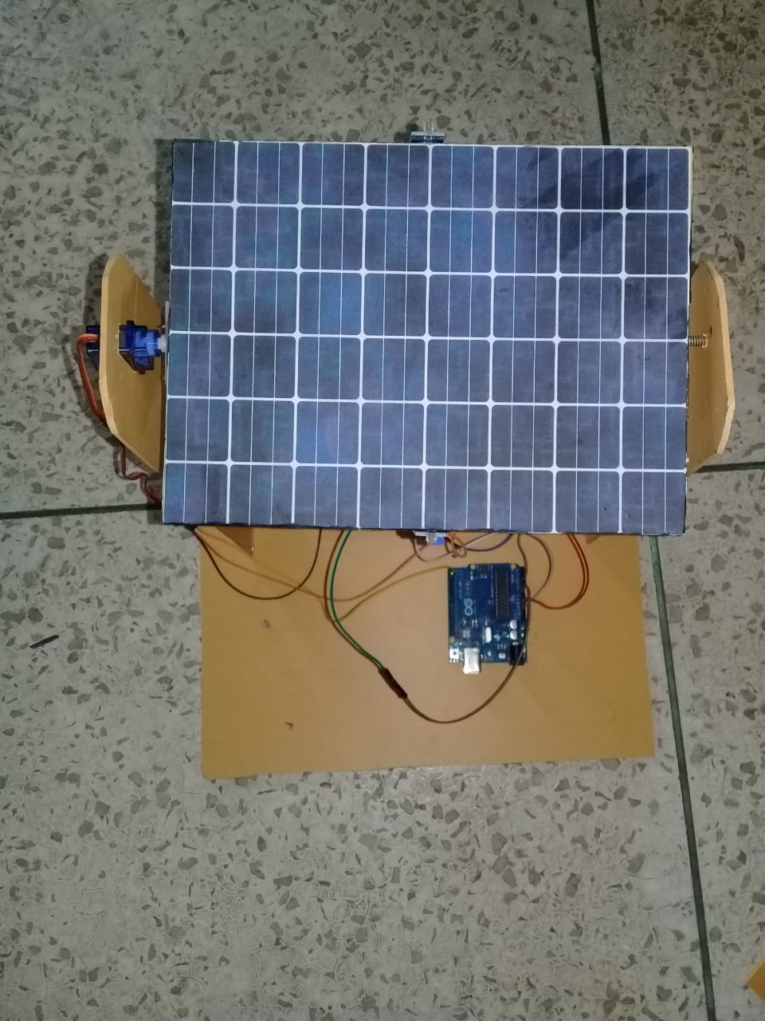
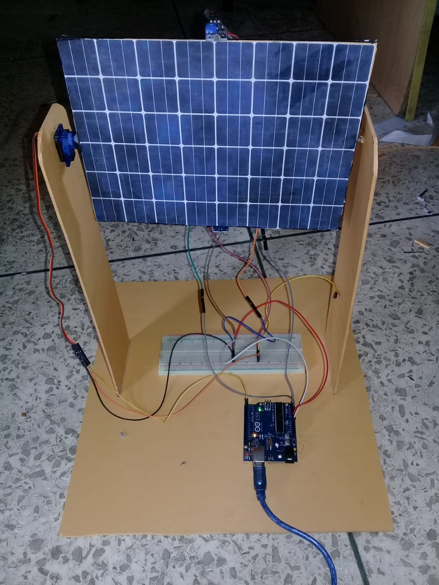
Result With Image
4
Top
5
Final

Slide 17
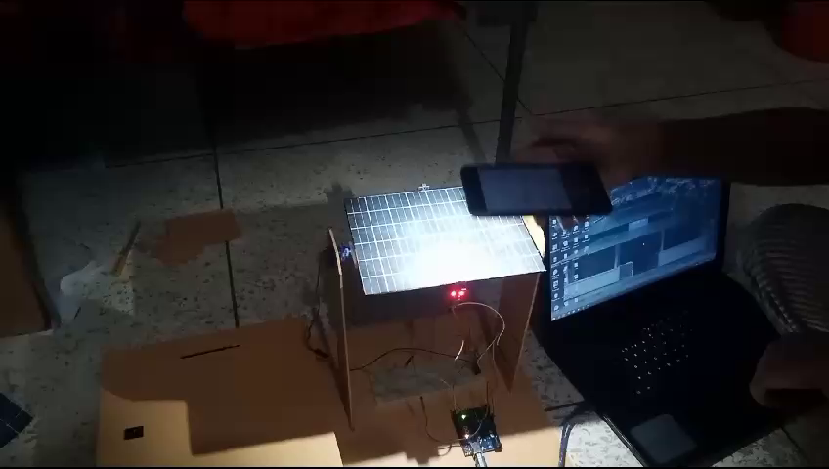

Slide 18
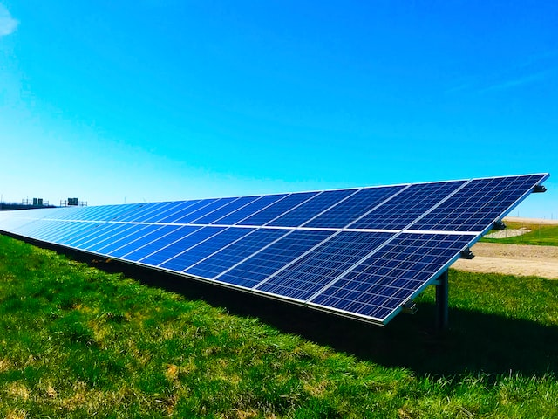
Advantages
The process of attaining solar energy is unsoiled.
It is a renewable source of energy.
Solar energy is a perennial source of energy.
There is no adulteration is the process of acquiring solar energy
The yield rate is very high, using solar panels.
Solar energy is very useful and can be easily drawn into applications in rural areas where the extraction of electricity is difficult.
Solar energy does not create noises compared to the noises created by machinery in the extraction of other natural resources.

Slide 19

Limitations
Panels With Trackers Are More Expensive
Panels with Solar Tracking Systems Usually Need More Maintenance
All tracking systems need a great deal of site preparation. Additional trenching for wiring and grading is required too.
Production of electricity is directly dependent on the energy captivated which is interlinked with the path the sun covers. This factor could bring many countries to a disadvantage.
The consumption of solar energy during the night requires the energy to be stored in large batteries, which would hence occupy a huge section.

Slide 20
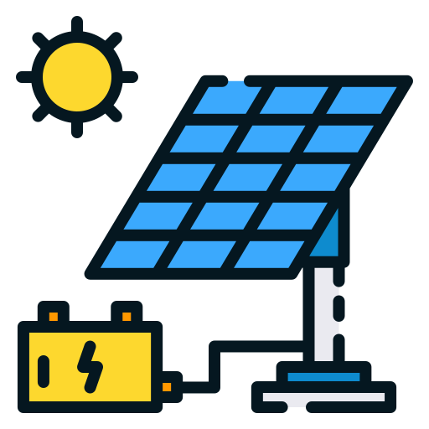

Future Scope
The very embodiment through which the futuristic conundrum is set aside is the project called “Automatic Sun Tracking System”. A trailblazer by its spirit, this system works with its utmost efficiency, whether that be in terms of its pecuniary ability or in terms of its accessibility. In the smoke of the darkness where pollution engulfs every sphere of advancement as an outcome of producibility, this device in its very efficiency work towards only advancement and development by flushing out the pollution at large.

Slide 21
Conclusion
The invention of solar tracking system helps us improve the performance of PV solar system in a simple way
Used relative method of sunlight strength
Improved the utilization rate of solar energy and efficiency of photovoltaic power generation system

Slide 22
Thank You !

